Slide 1

SLDS Project 1 Task 3 Open Study
Tuberculosis Incidence Prediction
2024 / 05 / 29

Slide 2

s
CATALOGUE
01
Data Acquisition & Understanding
02
Modeling & Improvement
03
Results & Analysis

Slide 3

01
Data Acquisition & Understanding

Slide 4
Data Acquisition & Understanding
Data Acquisition
https://data.worldbank.org/indicator?tab=all
Name | Abbreviation | Unit | Note
Total alcohol consumption per capita, male | alcohol_m | Liters of pure alcohol per capita | 15+ years of age
Total alcohol consumption per capita, female | alcohol_f | Liters of pure alcohol per capita | 15+ years of age
Prevalence of current tobacco use, males | tobacco_m | % of male adults
Prevalence of current tobacco use, females | tobacco_f | % of female adults
PM2.5 air pollution, mean annual exposure | pm25 | Micrograms per cubic meter
People using safely managed drinking water services | water | % of population
People using safely managed sanitation services | sanitation | % of population
Domestic general government health expenditure per capita | health_expenditure | Current international $ | PPP
Population density | population_density | People per sq. km of land area
Urban population | urban_population | % of total population
Incidence of tuberculosis | tuberculosis | Per 100,000 people | Response
Selection (Assumptions based on data selection):
____Most of developed countries in Europe (similar background features):
____ ____['GBR', 'FRA', 'DEU', 'ITA', 'NLD', 'NOR', 'SWE', 'FIN', 'DNK', 'ISL', 'CHE', 'BEL', 'LUX', 'IRL',
____ _____'ESP', 'PRT', 'AUT', 'CZE', 'SVK', 'HUN', 'GRC', 'SVN', 'POL', 'EST', 'LVA', 'LTU', 'MLT', 'CYP']
____2010 – 2023: No NaN.
4
Notes:
问题
数据来源
假设（限定数据）

Slide 5
Data Acquisition & Understanding
Data Understanding
Abbreviation | Intuitive Ideas
alcohol_m, alcohol_f | Alcohol consumption impairs liver function and may lower immunity
tobacco_m, tobacco_f | Tobacco damages the respiratory tract and may make you more susceptible to respiratory diseases
pm25 | PM2.5 impairs respiratory function, may lower resistance
water | Unsafe drinking water sources may contain pathogenic bacteria that induce tuberculosis
sanitation | Well-established, independent sanitation infrastructure reduces the likelihood of disease transmission
health_expenditure | Health expenditures have a multifaceted impact and may be representative of the country's overall health situation
population_density | High population density increases the probability of disease transmission
urban_population | Concentration of water and sewerage in urban areas may make disease transmission more likely
tuberculosis | Tuberculosis develops from Mycobacterium tuberculosis (bacterial infection)
5
Notes:
猜测

Slide 6
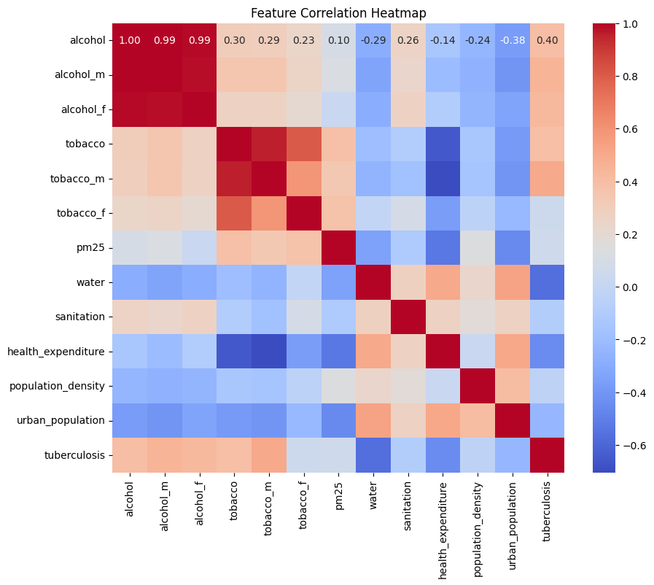
Data Acquisition & Understanding
Data Understanding
Sex-disaggregated raw data has high inter-sex correlation.
(Mainly alcohol)
alcohol_m and alcohol_f are highly covariant, perhaps one can be rounded up or down, and the difference is only reflected in the scale; this feature is weaker on tobacco.
2. Correlations between RESPONSE and gender-specific tobacco use data vary widely.
(Mainly tobacco)
Merge the original _m and _f data and separate sex as a new feature.
6
Notes:
相关性热图
比如tobacco的m和f对tuberculosis的相关性差异较大，故加入sex特征

Slide 7
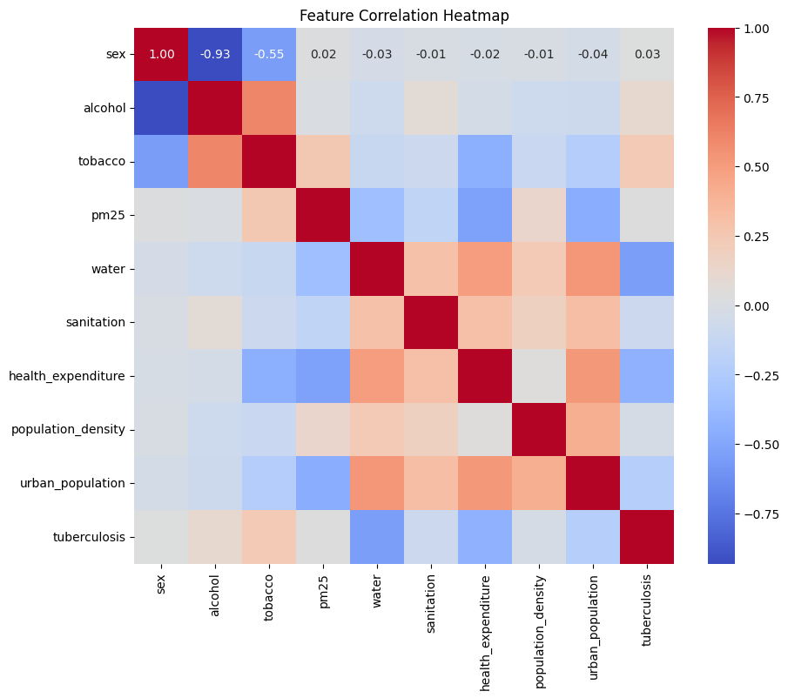
Data Acquisition & Understanding
Data Understanding
1. Higher correlation between sex, alcohol and tobacco.
Males generally drink more alcohol than females; the relationship is relatively less strong for tobacco use.
Subsequent consideration may need to be given to downscaling or adding non-linear terms.
2. High correlation between water, health_expenditure and response.
water may contribute more to the response.
3. Correlations between health_expenditure, urban_population and other characteristics are generally high.
Both indicators affect more aspects and are likely to have indirect links between them and other characteristics.
Subsequent downscaling may be considered.
7
Notes:
加入后观察特征间相关性
主要有两块地方
然后是response和特征相关性，主要water

Slide 8
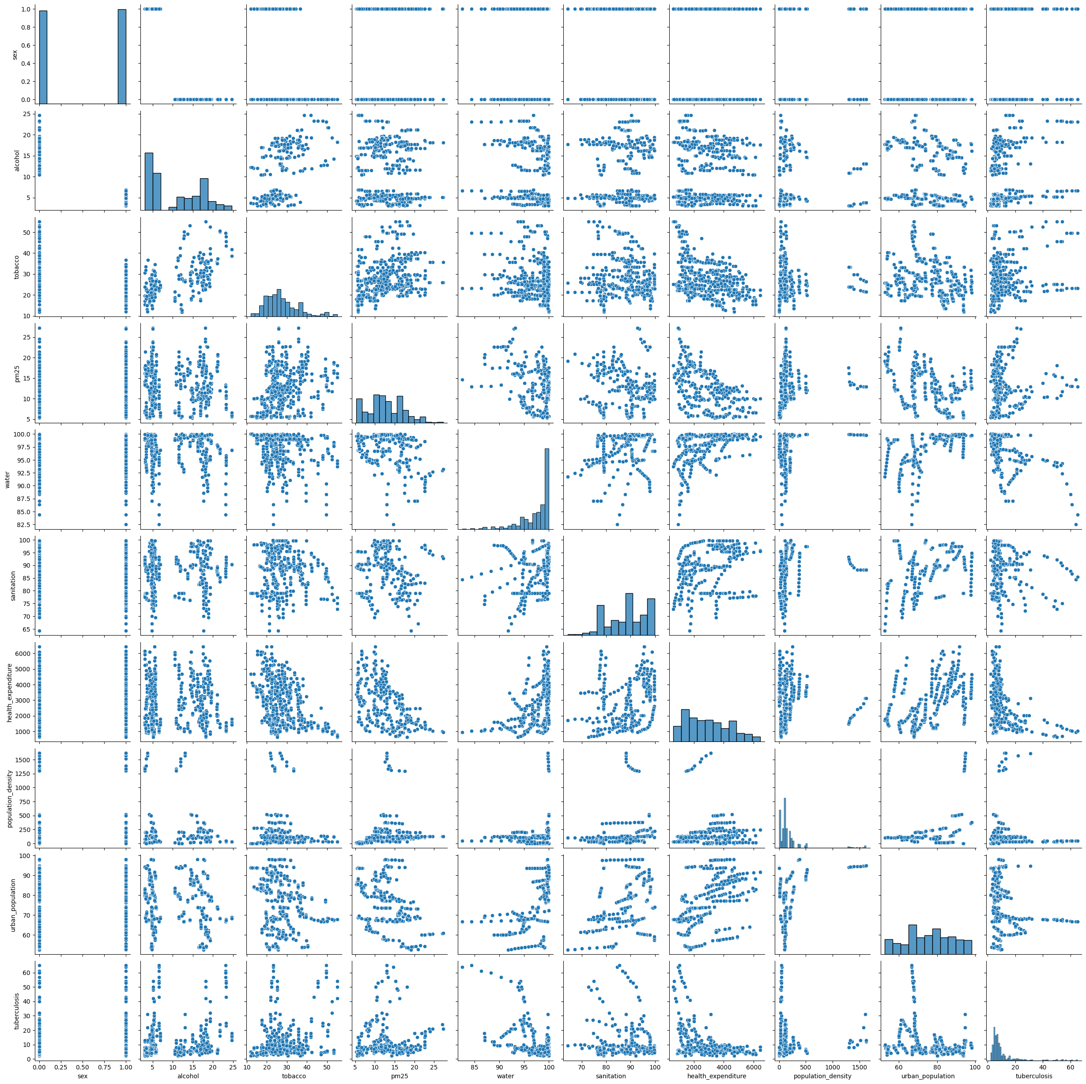
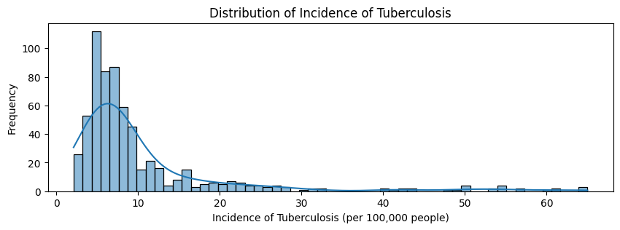
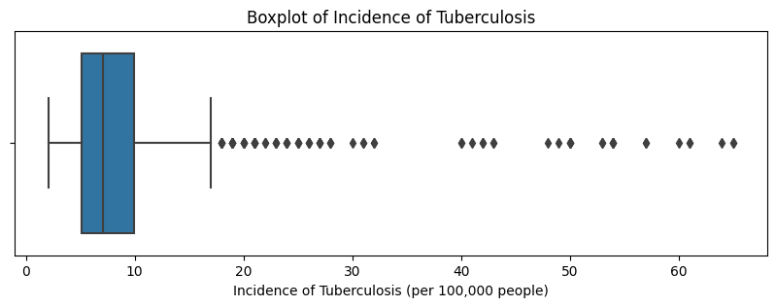
Data Acquisition & Understanding
(Pairplot)
Data Understanding
8
Notes:
Response 值整体集中在较低处：0 – 10，10 – 30，30 – ，数据量基本足够；
Pairplot 中可以观察到部分图中数据点明显分为两组，很可能与 sex 有关；
部分图中数据点不似线性，可能具有非线性特征；
……

Slide 9
02
Modeling & Improvement

Slide 10
Modeling & Improvement
Cross Validation
Next some improvement attempts are made for some of the models, which need to be verified whether the performance of the improved models is really improved.
Cross-validation is needed here, where different training and test sets are separated from the dataset each time, and the obtained test results are averaged as a basis for judgment to reduce chance.
10
Notes:
交叉验证

Slide 11
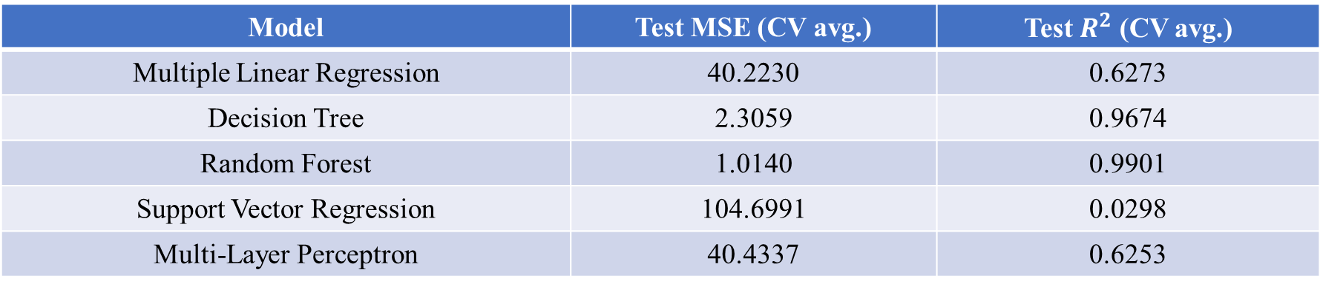
Modeling & Improvement
Modeling
Model | Test MSE (CV avg.) | Test $R^{2}$ (CV avg.)
Multiple Linear Regression | 40.2230 | 0.6273
Decision Tree | 2.3059 | 0.9674
Random Forest | 1.0140 | 0.9901
Support Vector Regression | 104.6991 | 0.0298
Multi-Layer Perceptron | 40.4337 | 0.6253
11
Notes:
基本模型
是交叉验证后去平均的值

Slide 12
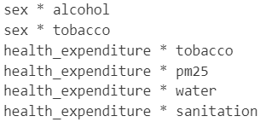
Modeling & Improvement
Interaction Terms & Non-linear Terms
The following optimization for MLR begins by considering the addition of non-linear cross terms for the reasons described in Data Understanding.
The main consideration is, for example, the effect of smoking on the incidence of tuberculosis may be moderated by the gender factor.
Random Forest (Interaction Terms)
Decision Tree (Interaction Terms)
Multiple Linear Regression (Interaction Terms)
Experiments with high order terms were added, and cross validation revealed poorer results, which are not shown here.
12

Slide 13
Modeling & Improvement
Interaction Terms & Non-linear Terms
Multiple Linear Regression (Interaction Terms)
OLS Regression Results
==============================================================================
Dep. Variable: tuberculosis R-squared: 0.644
Model: OLS Adj. R-squared: 0.635
Method: Least Squares F-statistic: 73.61
Date: Wed, 29 May 2024 Prob (F-statistic): 5.37e-126
Time: 08:59:36 Log-Likelihood: -2037.5
No. Observations: 627 AIC: 4107.
Df Residuals: 611 BIC: 4178.
Df Model: 15
Covariance Type: nonrobust
===================================================================================================
coef std err t P>|t| [0.025 0.975]
---------------------------------------------------------------------------------------------------
const 400.7548 24.205 16.557 0.000 353.219 448.290
sex -0.6447 3.429 -0.188 0.851 -7.379 6.090
alcohol 0.7754 0.144 5.369 0.000 0.492 1.059
tobacco 0.2861 0.070 4.068 0.000 0.148 0.424
pm25 -1.1802 0.166 -7.099 0.000 -1.507 -0.854
water -3.9259 0.228 -17.208 0.000 -4.374 -3.478
sanitation -0.0322 0.083 -0.387 0.699 -0.195 0.131
health_expenditure -0.1344 0.011 -12.199 0.000 -0.156 -0.113
population_density 0.0092 0.001 7.868 0.000 0.007 0.012
urban_population -0.0674 0.035 -1.906 0.057 -0.137 0.002
sex * alcohol 2.8738 0.476 6.038 0.000 1.939 3.809
sex * tobacco -0.0835 0.103 -0.811 0.418 -0.286 0.119
health_expenditure * tobacco -5.324e-05 2.75e-05 -1.933 0.054 -0.000 8.37e-07
health_expenditure * pm25 0.0001 6.43e-05 1.852 0.065 -7.21e-06 0.000
health_expenditure * water 0.0014 0.000 11.839 0.000 0.001 0.002
health_expenditure * sanitation -4.466e-05 2.6e-05 -1.720 0.086 -9.56e-05 6.33e-06
==============================================================================
Omnibus: 149.362 Durbin-Watson: 2.035
Prob(Omnibus): 0.000 Jarque-Bera (JB): 735.252
Skew: 0.974 Prob(JB): 2.20e-160
Kurtosis: 7.935 Cond. No. 4.28e+07
==============================================================================
13

Slide 14
Modeling & Improvement
Interaction Terms with Stepwise Selection
After adding all possible cross terms to the dataset, feature selection is performed using Forward Selection and Mixed Selection, respectively, to retain the features that are more significant and make the model better.
e.g. Mixed Selection from interaction terms:
OLS Regression Results
==============================================================================
Dep. Variable: tuberculosis R-squared: 0.613
Model: OLS Adj. R-squared: 0.606
Method: Least Squares F-statistic: 88.54
Date: Wed, 29 May 2024 Prob (F-statistic): 6.03e-119
Time: 08:59:39 Log-Likelihood: -2063.5
No. Observations: 627 AIC: 4151.
Df Residuals: 615 BIC: 4204.
Df Model: 11
Covariance Type: nonrobust
===========================================================================================================
coef std err t P>|t| [0.025 0.975]
-----------------------------------------------------------------------------------------------------------
const 134.6730 11.022 12.219 0.000 113.028 156.318
water -1.3870 0.118 -11.772 0.000 -1.618 -1.156
pm25 * health_expenditure -0.0003 3.09e-05 -8.613 0.000 -0.000 -0.000
health_expenditure * population_density 3.681e-06 3.94e-07 9.350 0.000 2.91e-06 4.45e-06
tobacco * sanitation -0.0055 0.001 -4.638 0.000 -0.008 -0.003
sex * alcohol 4.3055 0.407 10.591 0.000 3.507 5.104
alcohol * tobacco 0.0521 0.005 10.235 0.000 0.042 0.062
sex * health_expenditure -0.0058 0.001 -7.449 0.000 -0.007 -0.004
health_expenditure * urban_population 2.438e-05 8.28e-06 2.945 0.003 8.12e-06 4.06e-05
alcohol * health_expenditure -0.0003 6.26e-05 -4.735 0.000 -0.000 -0.000
sanitation * health_expenditure 5.139e-05 1.39e-05 3.707 0.000 2.42e-05 7.86e-05
sex * tobacco 0.2178 0.097 2.236 0.026 0.027 0.409
==============================================================================
Omnibus: 138.653 Durbin-Watson: 2.060
Prob(Omnibus): 0.000 Jarque-Bera (JB): 378.339
Skew: 1.095 Prob(JB): 6.99e-83
Kurtosis: 6.113 Cond. No. 4.32e+07
==============================================================================
14

Slide 15
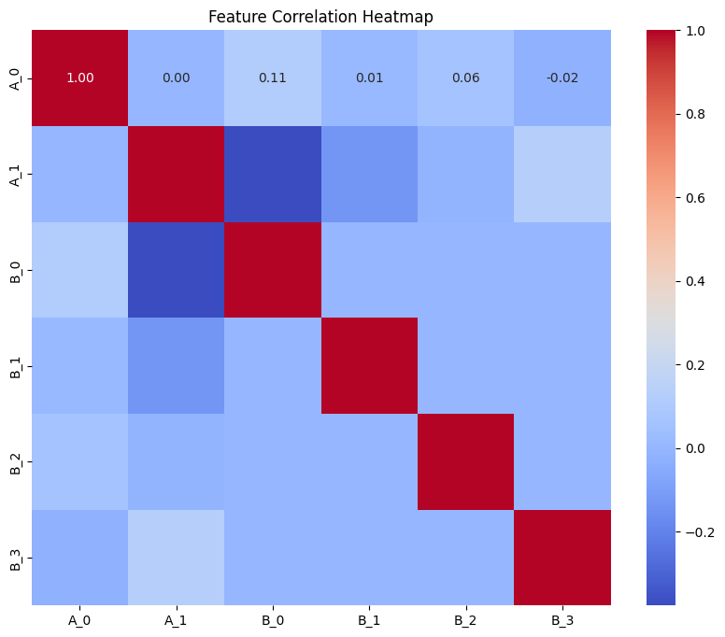
Modeling & Improvement
PCA Before MLR
15

Slide 16
03
Results & Analysis

Slide 17
Results & Analysis
Test Results
Model Test MSE (Cross Validated avg.) Test R2 (Cross Validated avg.)
Random Forest 1.0140 0.9901
Random Forest (Interaction Terms) 1.8464 0.9816
Decision Tree 2.3059 0.9674
Decision Tree (Interaction Terms) 3.2844 0.9631
Multiple Linear Regression (Interaction Terms) 25.6760 0.7621
Multiple Linear Regression (Mixed Selection) 33.3072 0.6914
Multiple Linear Regression (Forward Selection) 35.4460 0.6715
Multiple Linear Regression 40.2230 0.6273
Multi-Layer Perceptron 40.4337 0.6253
Multiple Linear Regression (PCA) 42.3802 0.6073
Support Vector Regression 104.6991 0.0298
Random forests and decision trees fitted best, which may mean that there are more nonlinear relationships in the problem;
In the average case, the further artificial inclusion of the cross terms resulted in worse results.
Multiple linear regression is significantly more effective with the addition of the cross terms;
What is not shown here is that the average effect is still boosted after all possible cross terms are added.
Support vector regression has the worst results with different kernel functions.
17
Notes:
随机森林和决策树的拟合效果最佳，这可能意味着该问题中的非线性关系较多；
在平均情况下，再人为加入交叉项导致效果变差了。TODO
多变量线性回归在加入交叉项后效果明显提升；
未在这里显示的是，将所有可能交叉项全部加入后，平均效果依然提升。
支持向量回归在不同核函数下效果都是最差。TODO

Slide 18
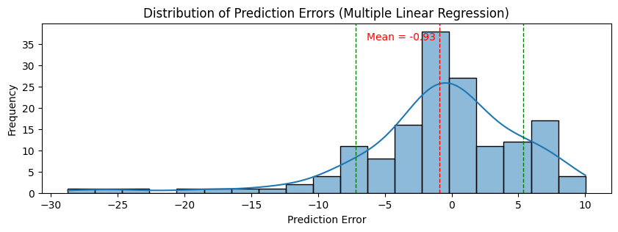
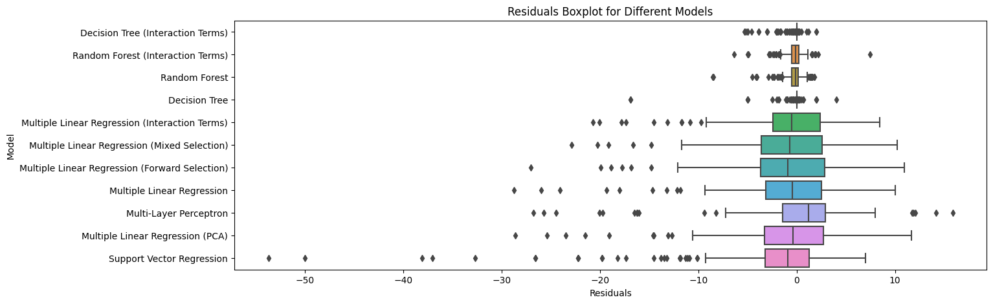
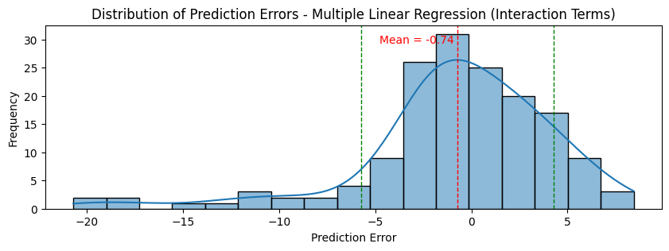
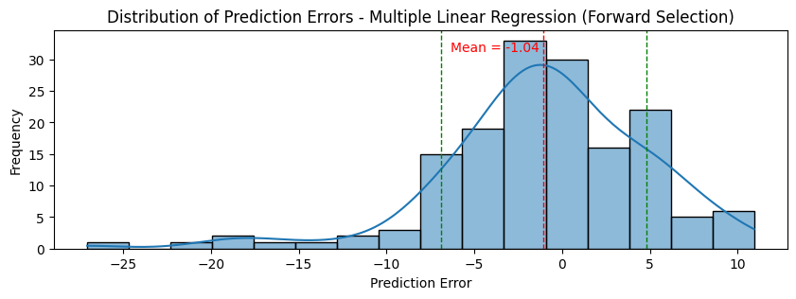
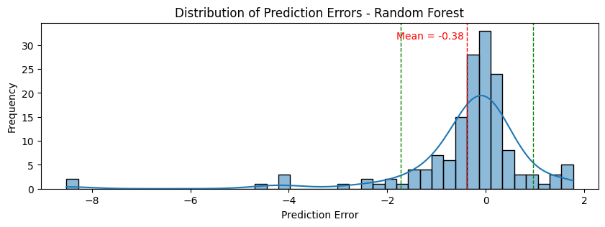
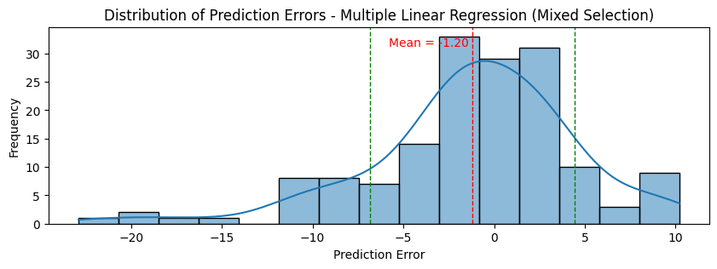
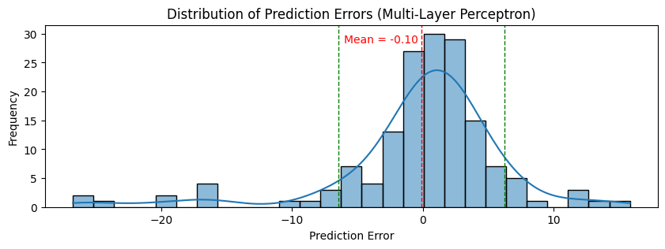
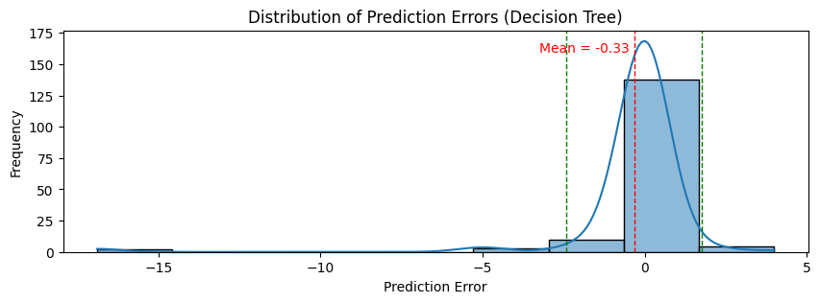
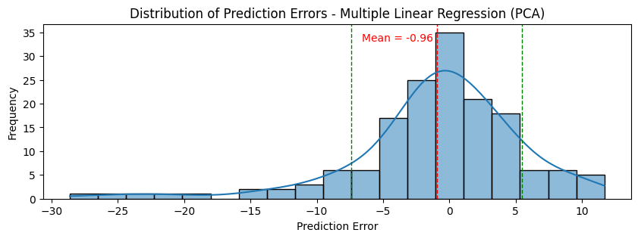
Results & Analysis
Residuals (One of trials as an example)
18

Slide 19
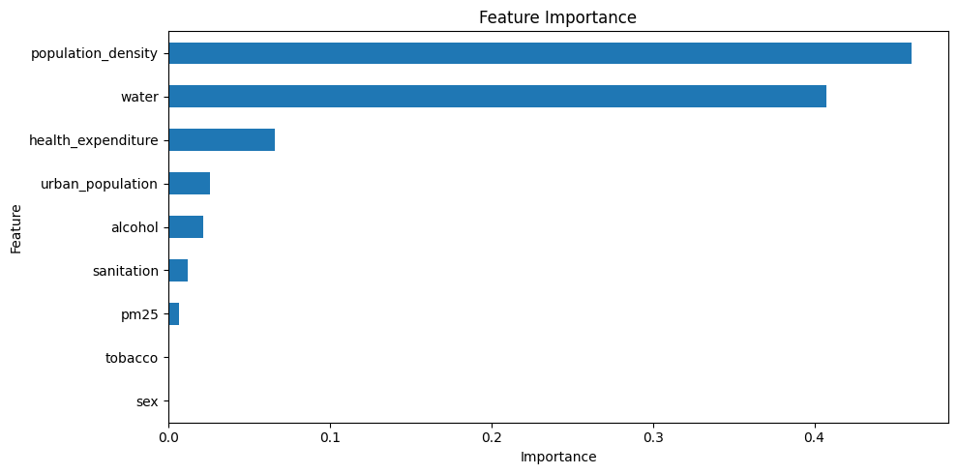
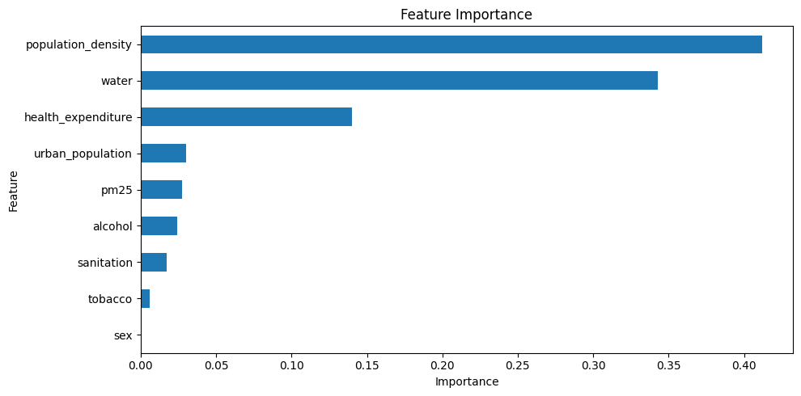
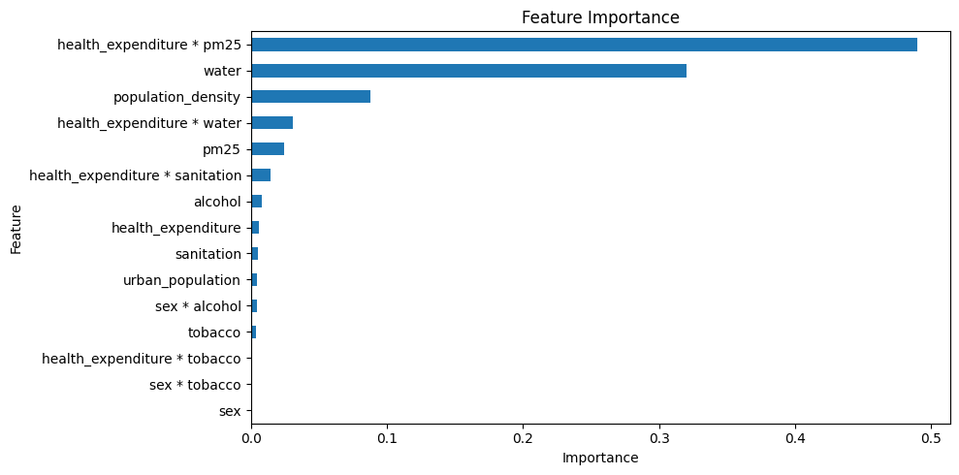
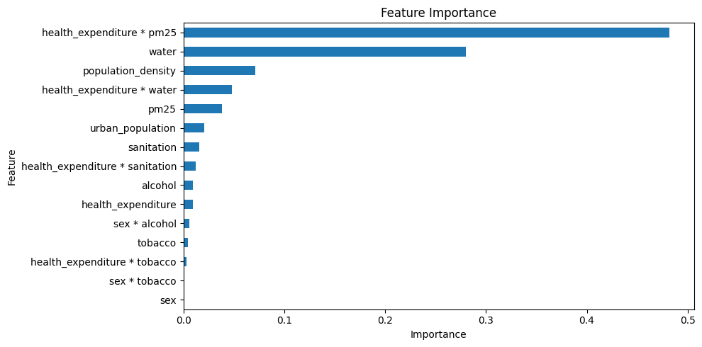
Results & Analysis
Feature Importance
Decision Tree
Random Forest
Decision Tree (Interaction Terms)
Random Forest (Interaction Terms)
19

Slide 20
Results & Analysis
Conclusions
依据原始的 Random Forest 和 Decision Tree 的结果，
考虑的特征中对结核病发病率影响最高的是人口密度和安全饮用水覆盖率，
其它特征中，卫生支出、城镇人口率、饮酒、PM2.5、卫生基础设施覆盖率有较显著的贡献，
而性别、吸烟率则对结核病发病率影响不大。
对比最初的猜测，可能酗酒对肝脏和免疫系统的破坏在针对结核病方面要更严重于吸烟对呼吸道的损害。
Decision Tree
Random Forest
20

Slide 21
Results & Analysis
Conclusions
OLS Regression Results
==============================================================================
Dep. Variable: tuberculosis R-squared: 0.644
Model: OLS Adj. R-squared: 0.635
Method: Least Squares F-statistic: 73.61
Date: Wed, 29 May 2024 Prob (F-statistic): 5.37e-126
Time: 08:59:36 Log-Likelihood: -2037.5
No. Observations: 627 AIC: 4107.
Df Residuals: 611 BIC: 4178.
Df Model: 15
Covariance Type: nonrobust
===================================================================================================
coef std err t P>|t| [0.025 0.975]
---------------------------------------------------------------------------------------------------
const 400.7548 24.205 16.557 0.000 353.219 448.290
sex -0.6447 3.429 -0.188 0.851 -7.379 6.090
alcohol 0.7754 0.144 5.369 0.000 0.492 1.059
tobacco 0.2861 0.070 4.068 0.000 0.148 0.424
pm25 -1.1802 0.166 -7.099 0.000 -1.507 -0.854
water -3.9259 0.228 -17.208 0.000 -4.374 -3.478
sanitation -0.0322 0.083 -0.387 0.699 -0.195 0.131
health_expenditure -0.1344 0.011 -12.199 0.000 -0.156 -0.113
population_density 0.0092 0.001 7.868 0.000 0.007 0.012
urban_population -0.0674 0.035 -1.906 0.057 -0.137 0.002
sex * alcohol 2.8738 0.476 6.038 0.000 1.939 3.809
sex * tobacco -0.0835 0.103 -0.811 0.418 -0.286 0.119
health_expenditure * tobacco -5.324e-05 2.75e-05 -1.933 0.054 -0.000 8.37e-07
health_expenditure * pm25 0.0001 6.43e-05 1.852 0.065 -7.21e-06 0.000
health_expenditure * water 0.0014 0.000 11.839 0.000 0.001 0.002
health_expenditure * sanitation -4.466e-05 2.6e-05 -1.720 0.086 -9.56e-05 6.33e-06
==============================================================================
Omnibus: 149.362 Durbin-Watson: 2.035
Prob(Omnibus): 0.000 Jarque-Bera (JB): 735.252
Skew: 0.974 Prob(JB): 2.20e-160
Kurtosis: 7.935 Cond. No. 4.28e+07
==============================================================================
依据优化的 MLR 的结果，
考虑的特征中对结核病发病率影响最高的是也是安全饮用水覆盖率，
性别、卫生基础设施对发病率影响不显著，
其他单独特征对结果的影响均有较高的显著性。
城镇人口率以及卫生支出相关的交叉项影响都略不显著，
卫生支出与饮用水覆盖率的交叉项对结果有显著影响。
21
Notes:
高医疗支出可能在一定程度上缓解高PM2.5浓度对健康的负面影响。换句话说，高医疗支出的地区可能有更好的医疗设备和技术，更有效的污染应对措施，从而减少PM2.5对居民健康的损害。
当PM2.5浓度高时，医疗支出对健康的影响可能更显著。这可能是因为高PM2.5浓度会增加医疗需求，使得医疗支出的效应更加明显。

Slide 22
Results & Analysis
Conclusions
依据模型之间的对比结果，
决策树和随机森林模型拟合效果远超其它模型，此二者适合处理非线性关系，
故该问题的特征与响应间可能存在较多的非线性关系，
MLR 的 R2 值也无法大幅提升，
同样地 SVR 效果也较差。
22

Slide 23
Results & Analysis
TODO
23

Slide 24
THANK YOU

